Slide 1
Cyclops Project
Data Science Division, Statistics Canada
Presentation 4 – November 25, 2019

Slide 2
Database query (API Calls)
Input OCR extraction text file (json file)
NPN number
Product Name
Company Name
Product_License File
Lnhpd_id
API Query
Medical Ingred
API Query
Non-Medical Ingred
API Query
Med Claims

Slide 3
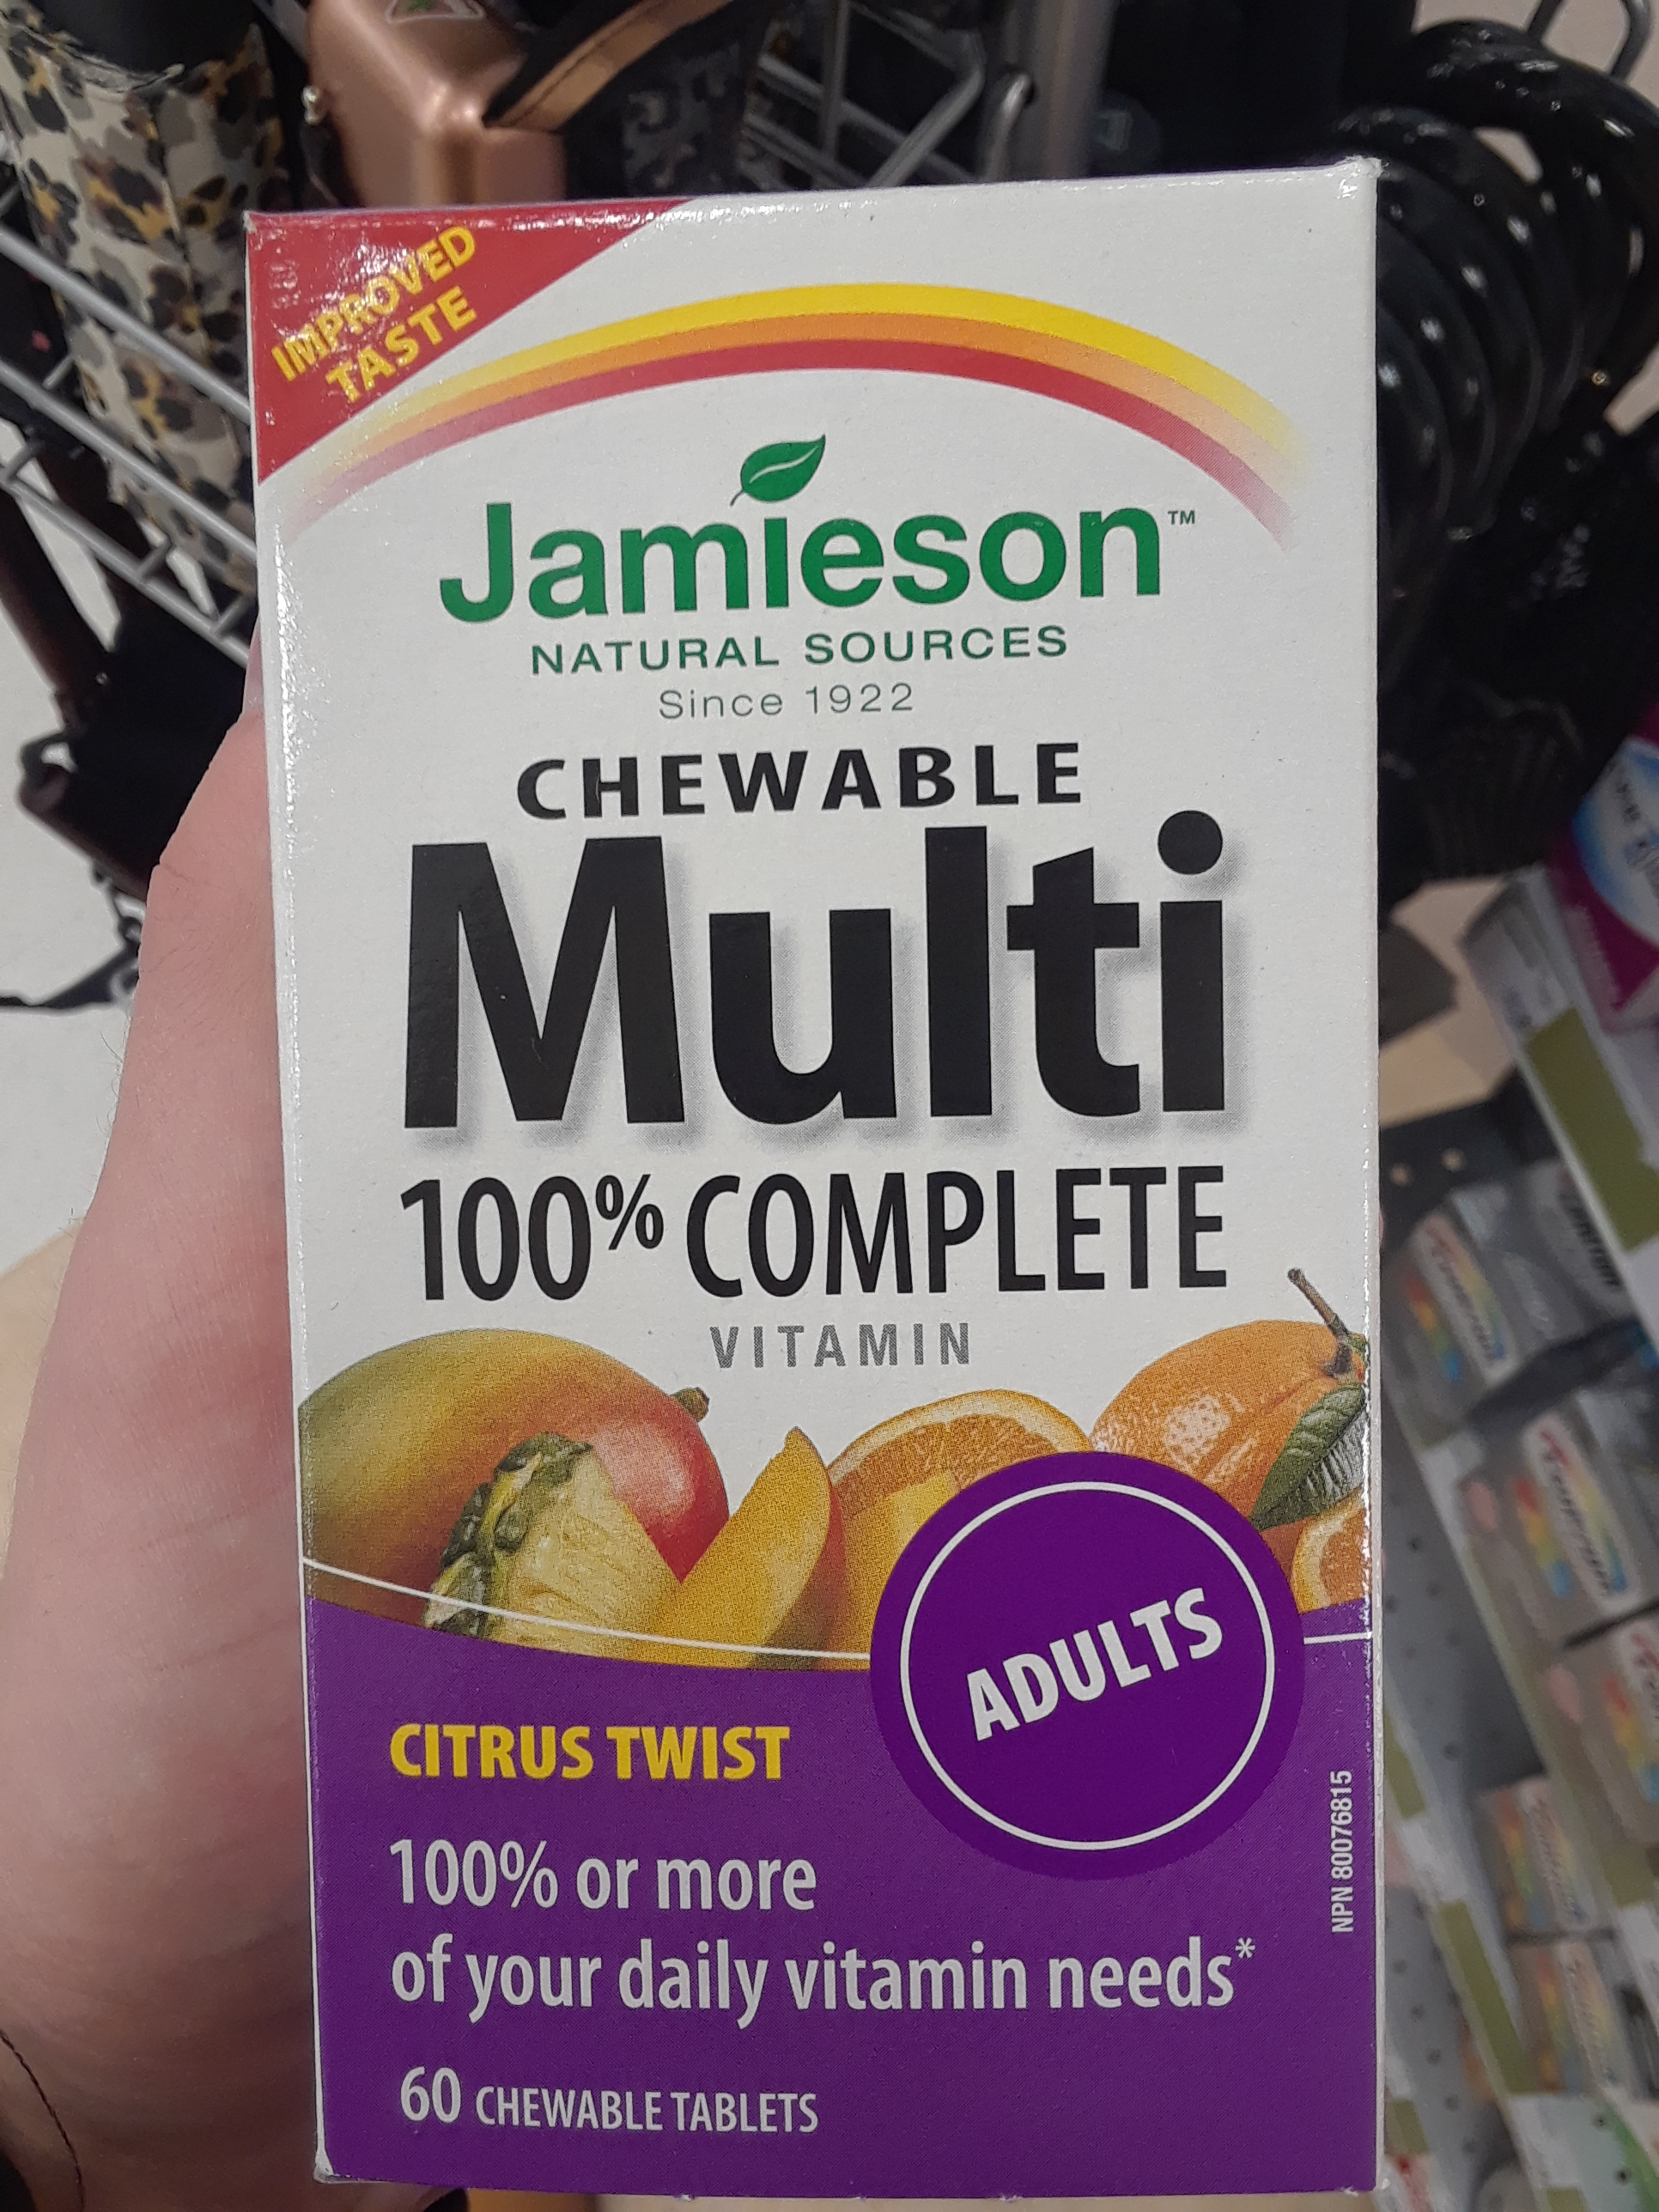
Database query
No NPN number shows up from Medical Image
- Only look at Medical Product Name & Company Name
OCR Extraction
- Product Name: chewable multi 100” complete vitamin
- Company Name: Jamieson
Top 10 matched medical products
- Parental 100 Complete Multivitamin
- Parental Multi 100 Complete
100 Complete MultiVitamin
Multi 100 Complete For Women
Multi 100 Complete For Men
Parental 100 Complete Multivitamin with Dha
Chewable Tropical Vitamin D
Multi 100 Complete For Women 50
Multi 100 Complete Complete Chewable
Correct One
-100% Complete Chewable Multivitamin For Adults

Slide 4
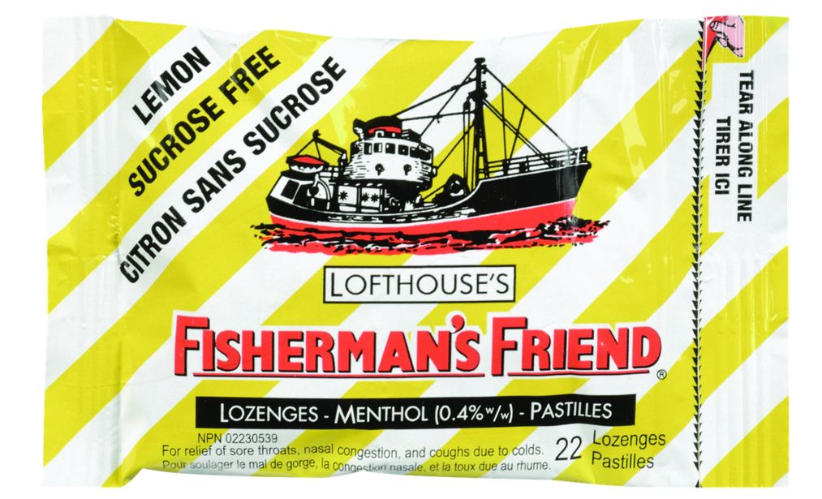
Database query
OCR Extraction
Product Name: lofthouse’s fishermans friend surose free lemon sans sucrose
- Company Name: LOFTHOUSE
Correct One
-Company: TFB & Associates Ltd.

Slide 5
Thank you!

